Slide 1










Presentation
School of AI-Beijing
王瑞华、谭永川、刘毅然、蒋宝尚、周启红

Slide 2






Introduction
目 录
CONTENTS
Course Content
Learning Experience
Practice

Slide 3


01
Introduction

Slide 4
数学基础
数学？数学！
Mathematics? Mathematics!
如果你想开始深度学习，那么必然面临这样两个选择：本科学过微积分、线性代数、概率论吗？
If you want to start deep learning, you must face two choices: Have you learned calculus, linear algebra, probability theory in college?
学过? yes?
没学过 No?
若没学过怎么办？
What if I haven't studied?

Slide 5
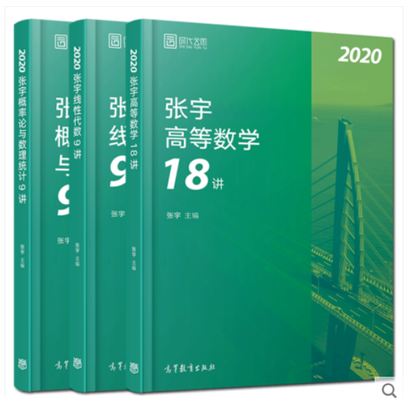
考研数学三大科目都与深度学习有相关，但是线性代数和概率论，尤其是概率论相关最大。
The three major subjects of postgraduate mathematics are related to deep learning, but linear algebra and probability theory, especially probability theory, are the most relevant ones.
考研数学大法好，我有宇哥我自豪
I am proud of Zhang Yu, a famous math teacher.
张宇数学考研36讲配套视频，主要看线性代数和概率论
ZhangYu’s PubMed 36 lessons video, mainly looking at linear algebra and probability theory
+

Slide 6
数据概览
数据清洗！数据清洗！
Data cleaning! Data cleaning!
数据分析最重要的是得有数据
The most important thing in data analysis is to have data.
数据分析最花时间的是数据清洗。
The most important thing in data analysis is data cleaning.
一个项目可能有90%的时间在清洗数据
A project may use 90% of the time to clean the data.

Slide 7
关于python
Python的三个库必须掌握：pandas、numpy、matplotlib
Python‘s three libraries that must be mastered： pandas, numpy, matplotlib
Python很好学，网上有很多优秀的视频，这里就不一一介绍了。
Python is very simple. There are a lot of excellent videos on the Internet. I won't introduce them here.

Slide 8
02
Course Content

Slide 9
课程学习概览
机器学习分类与基本流程
机器学习的一些基本概念
自定义数据集在fastai上的处理
03
第二课
第三课
交流宠物分类课程作业情况
02
6.16
第五课
高效学习方法
深度学习发展史
人工智能、机器学习
、深度学习概念上的区别
少花心思学工具，多学理论基础
05
RNN递归神经网络的基本结构与应用
NLP技术发展过程
第一课
01
04
第四课
google机器学习速成课
CNN卷积神经网络基本概念与特性
卷积神经网络结构

Slide 10
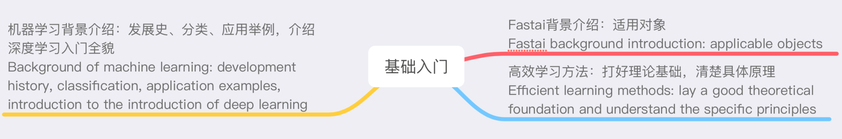
Lesson one
第一课

Slide 11
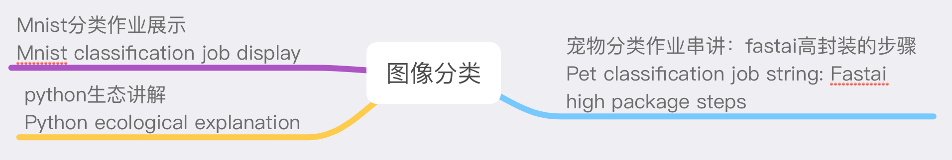
Lesson two
第二课
Notes:
下面我将从项目概述、需求分析、概要设计、详细设计、项目难点与测试总结六个部分展开介绍

Slide 12
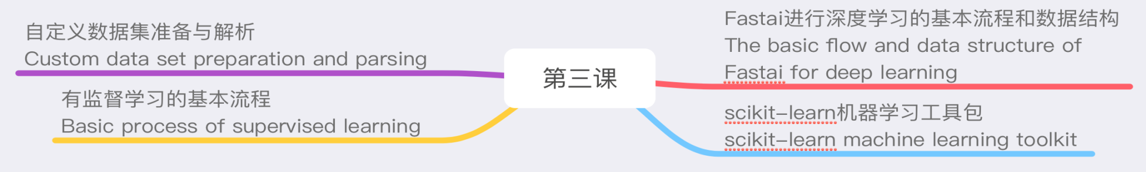
Lesson three
第三课
Notes:
下面我将从项目概述、需求分析、概要设计、详细设计、项目难点与测试总结六个部分展开介绍

Slide 13
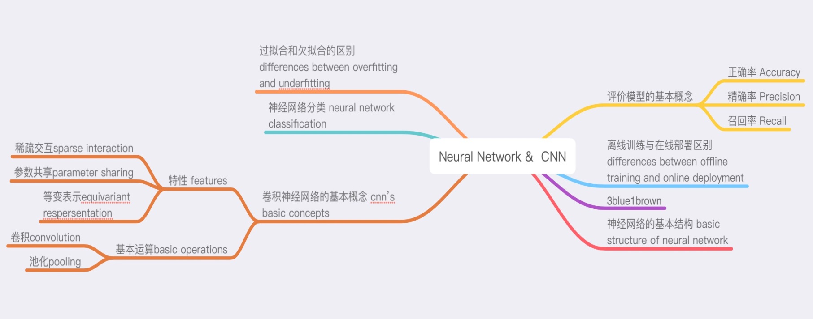
Lesson four
第四课

Slide 14
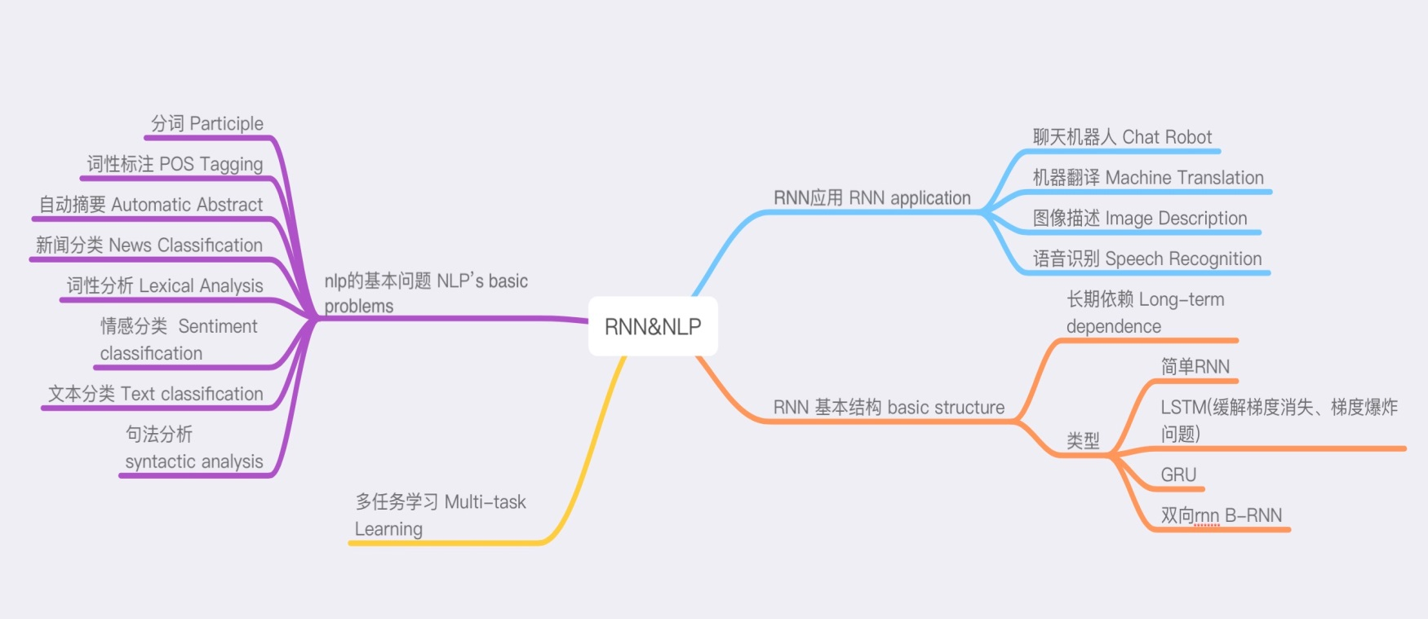
Lesson five
第五课

Slide 15
03
Learning Experience

Slide 16

关于3大库
Three major python libraries
Numpy，Pandas，Matplotlib是深度学习和机器学习经常用的三大python库，是属于必学的内容，推荐的学习方法是视频学习+时间中学。在b站上有很多的教学视频，先通过视频掌握初步的基础函数然后再在深度学习的项目中逐渐加深学习。
Numpy, Pandas, and Matplotlib are the three major python libraries that are often used in deep learning and machine learning. They are the must-study content. The recommended learning method is video learning +practice. There are a lot of teaching videos on the bilibili, starting with the basic functions through the video and then gradually deepen the learning in the deep learning project.

Slide 17
关于框架
The framework
Tensorflow是由谷歌开发的开源深度学习框架，有很多的低阶实现。 Fastai让我看到了将这一切组合起来后的功能有多么强大。 Tensorflow呈现的内在，Fastai呈现的是外在，二者可以 相辅相成。
Tensorflow is an open source deep learning framework developed by Google and has many low-level implementations. Fastai showed me how powerful it is to combine all of this. Tensorflow presents the inner, Fastai presents the external, the two can complement each other.

Slide 18

关于框架的心得 Tips about the framework
1）新手只学Fastai会陷入一种强大的错觉，成为“调包怪”。但是从Tensorflow开始又会缺乏对整体大局的把控，同时因为Tensorflow的重复造轮子而产生畏难情绪。
1) Novices who only learn Fastai will fall into a strong illusion and become the person who only calls python packages. However, starting from Tensorflow, there will be a lack of control over the overall situation, and at the same time, because of the repetitive creation of wheels by Tensorflow, it makes people feel the difficulty.

Slide 19
关于框架的心得 Tips about the framework
2）最好的方法是用Fastai快速开始深度学习，了解深度学习的主要步骤，然后用Tensoflow去实现Fastai的细节。
2) The best way is to start deep learning with Fastai, learn the main steps of deep learning, and then use Tensoflow to implement the details of Fastai。

Slide 20
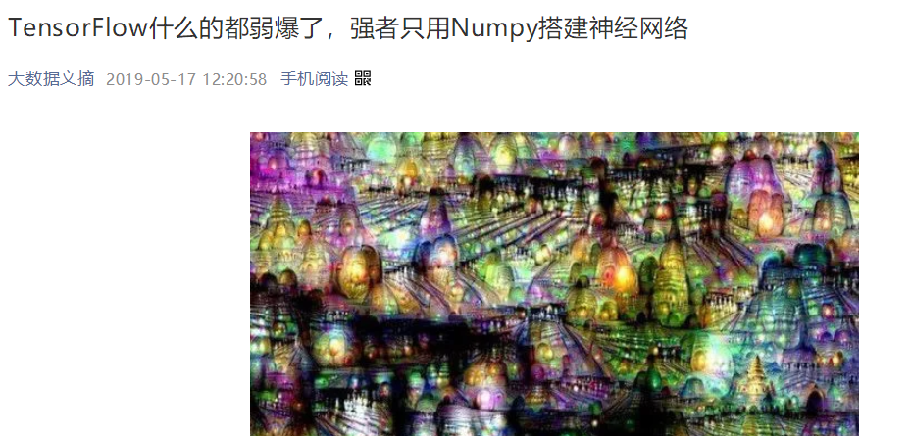
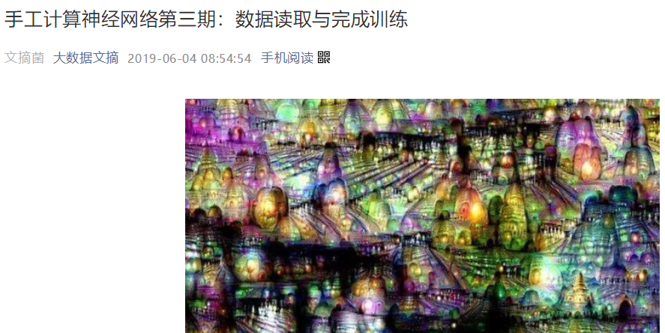

关于神经网络的心得 Tips about the framework
写了三期手工计算神经网络的文章。也就是使用Numpy搭建神经网络，理解背后的逻辑。Understand the logic behind the neural network

Slide 21
1.只是一个两层的神经网络。
2.用著名的MNIST的手写数据集训练过后准确率达到90%
3.数据为二进制储存，和读取文本数据的方式不一样。
4.这个简单的神经网络重要的是梯度下降，训练的核心也是梯度下降。
1.It's just a two-layer neural network.
2.After training with the MNIST dataset of handwritten digits, the accuracy rate is over to 90%.
3.The data is stored in binary system, which is different from reading text data.
4.The simple neural network is gradient decline, and the core of training is gradient decline.

Slide 22
04
Practice

Slide 23
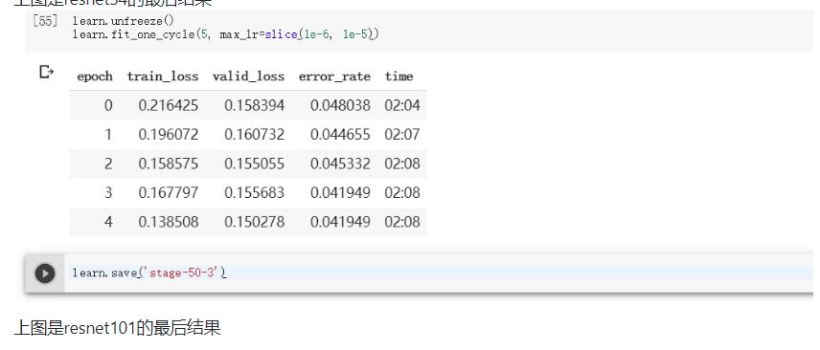
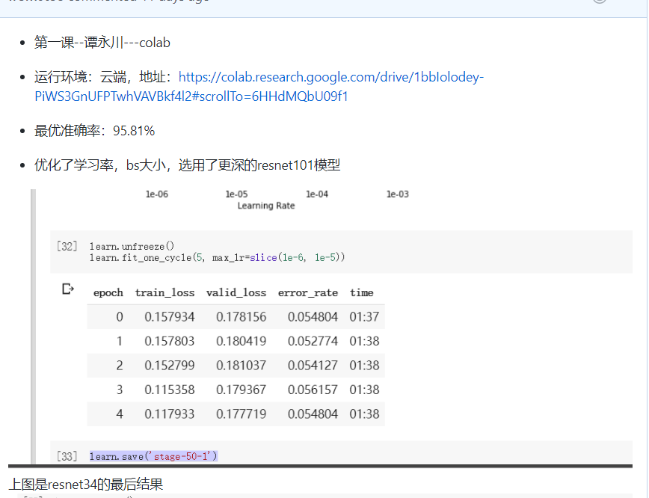
宠物分类改进
选用了resnet101，batchsize改为16，再优化了学习率在1e-6到1e-5之间。最后准确率在95.81%。

Slide 24
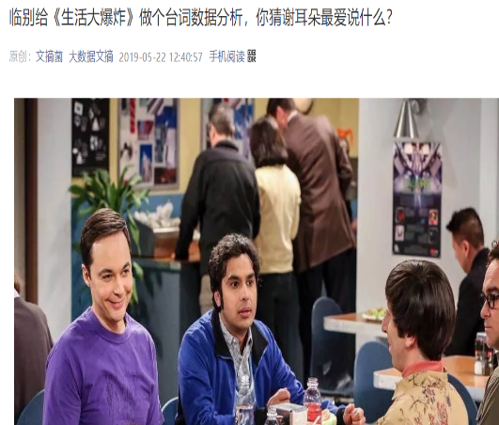
数据背后往往是真相
Behind the data is often the truth.
谢耳朵助攻女友跻身主角
With the assistance of Sheldon , his girlfriend plays the leading role
谢尔顿多榜第一霸占C位
Sheldon ranks first on the list and occupies the C position.
……
文本分析 Text analysis
词频统计 Word frequency statistics
停用词去除 Stop word removal
词云统计 Word cloud statistics
……
+

Slide 25
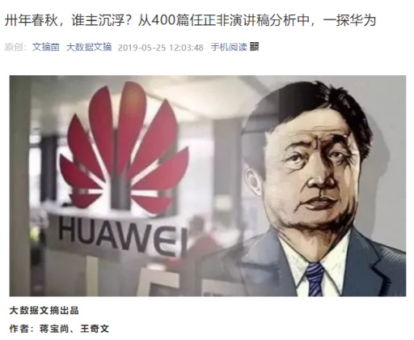
讲述数据背后的故事
Tell the story behind the data
通过数据透视华为发展历程
Perspective on the Development of Huawei through data
每个时期，华为都有不同的特点
Huawei has different characteristics in each period.
……
文本分析 Text analysis
词频统计 Word frequency statistics
停用词去除 Stop word removal
词云统计 Word cloud statistics
……
+

Slide 26

通过查论文看五月天歌词风格，找分析角度。
By Checking the Chinese rock band May Day `s lyrics ，find the band style.
加入了情感分析
Added emotional analysis
扩展了原有数据
Extended the original data
文本分析 Text analysis
词频统计 Word count & frequency statistics
停用词去除 Stop words removal
词云统计 Word cloud statistics
情感分析 Emotion analysis
……
+

Slide 27
NLP
Data: research article(2016-2018)
Size: 4023684
Task:
1.CSL academic word list
2.Wordcloud
Step:
1Download Research Papers from CNKI→ Convert PDF to text
2Data Cleaning
Name | items
Chinese Teaching in the World | 119
Language Teaching and Linguistic Studies | 196
International Chinese Language Education | 142
Journal of International Chinese Teaching | 168
Total | 625

Slide 28
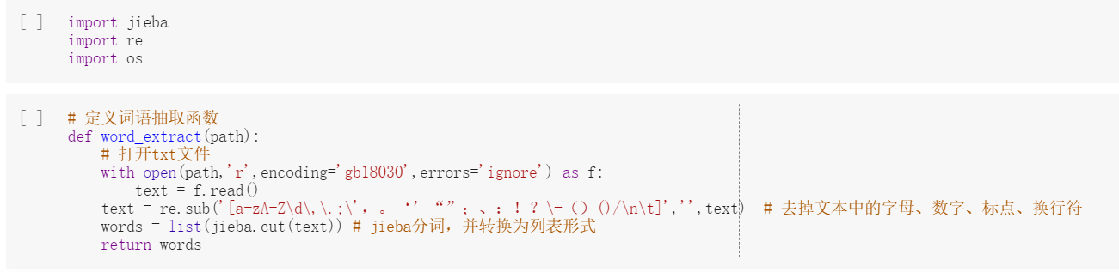
https://colab.research.google.com/drive/1jKELsJMgpnESoJGNcpUJE27hawJe1ZOp
+

Slide 29
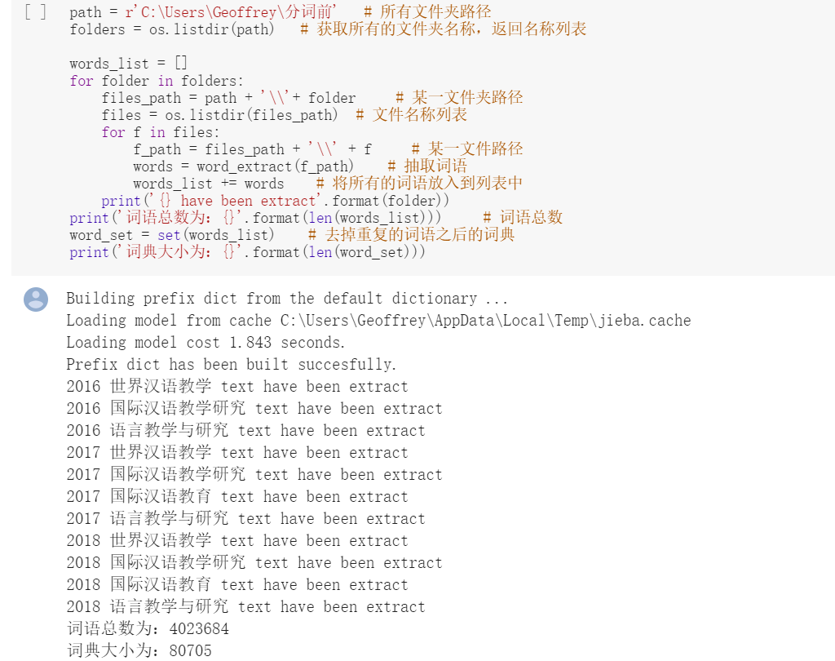
+

Slide 30
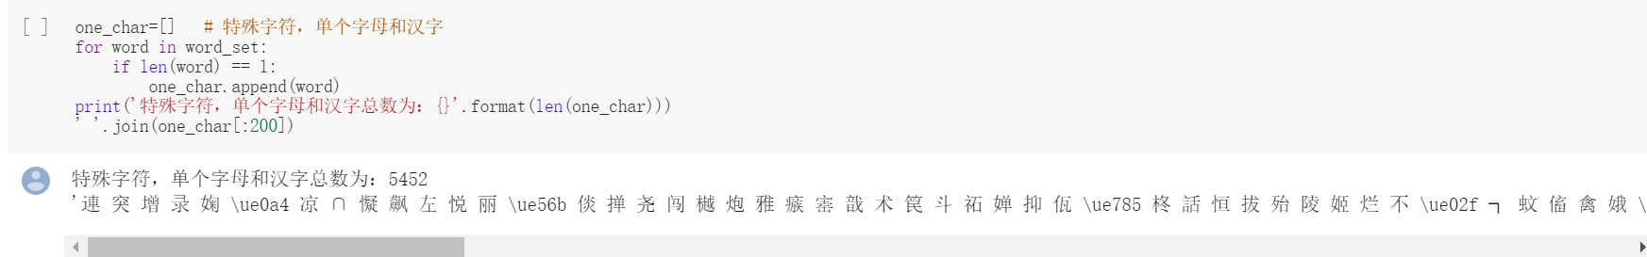
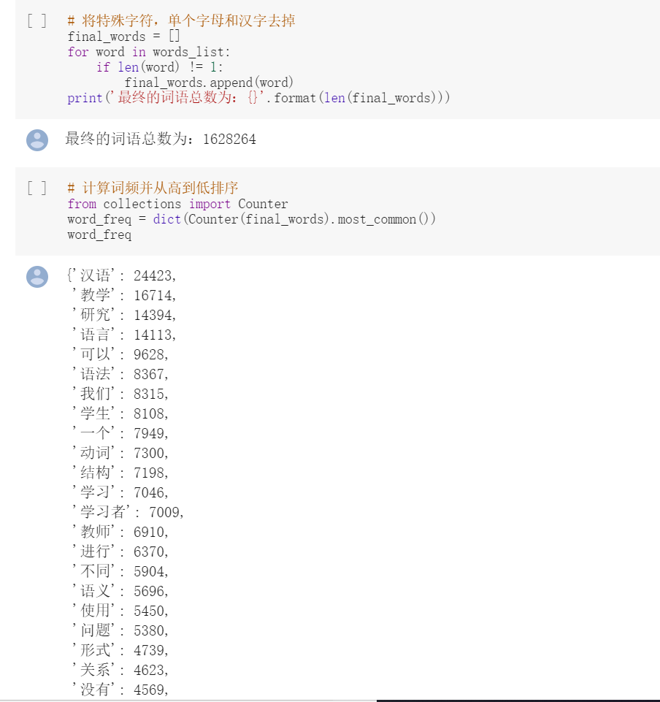
+

Slide 31
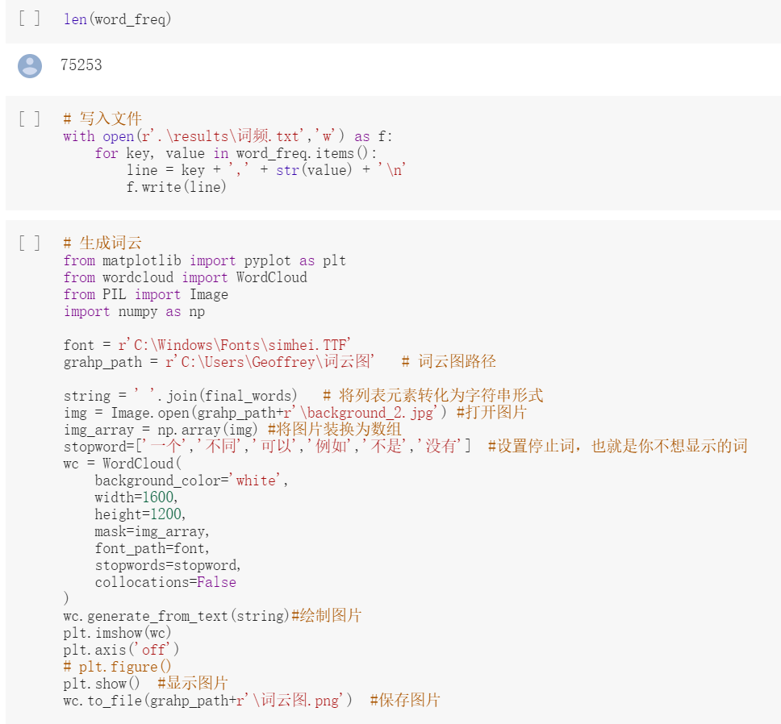
+

Slide 32


+

Slide 33


+

Slide 34
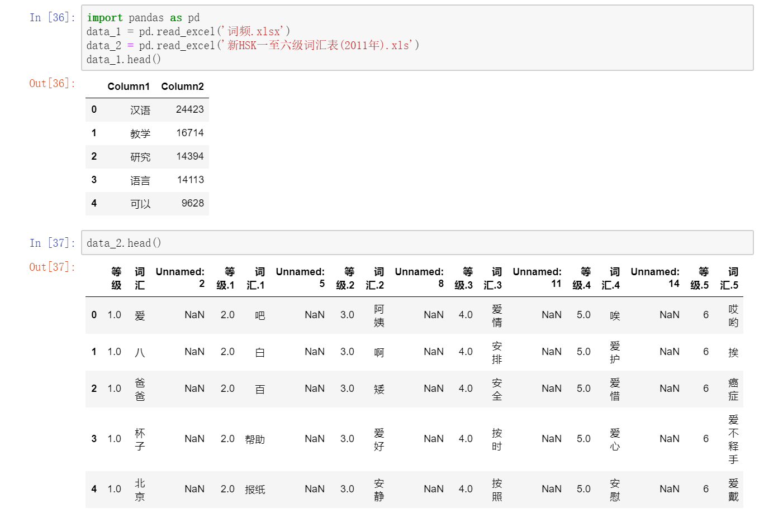

Slide 35
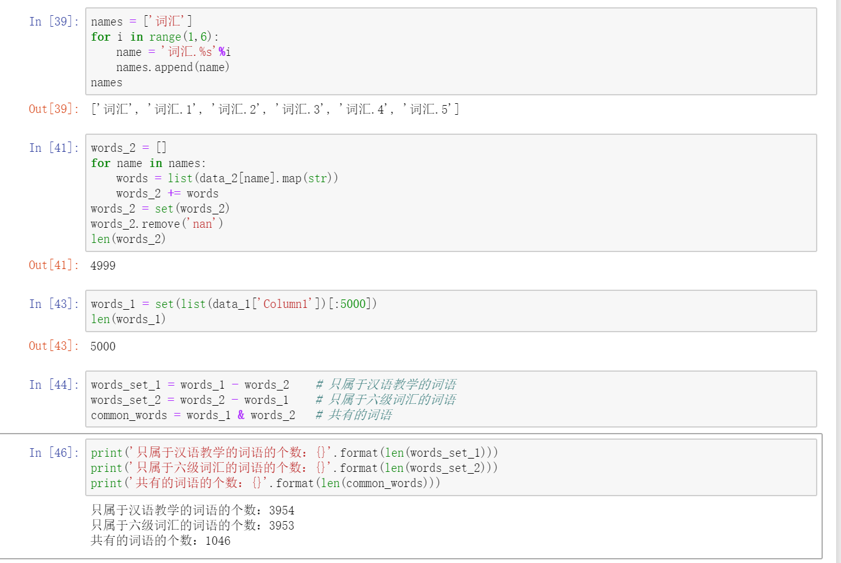

Slide 36
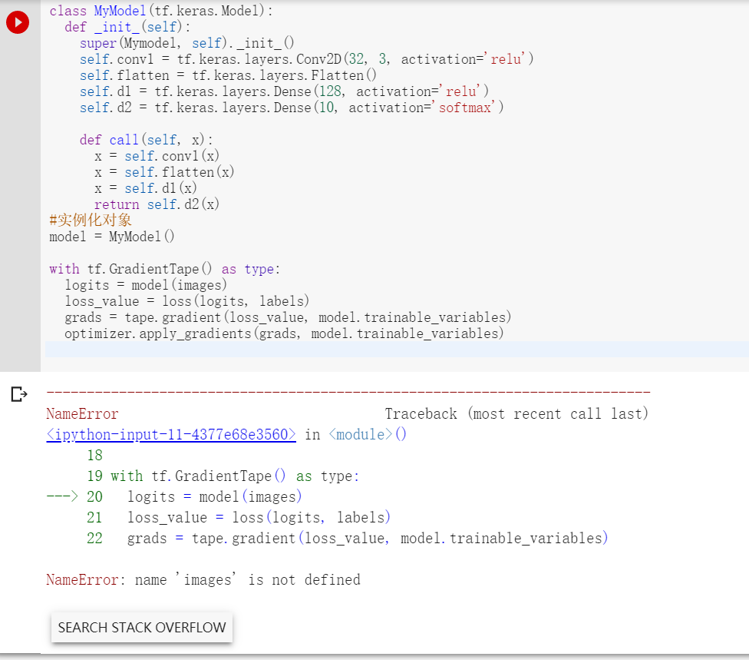
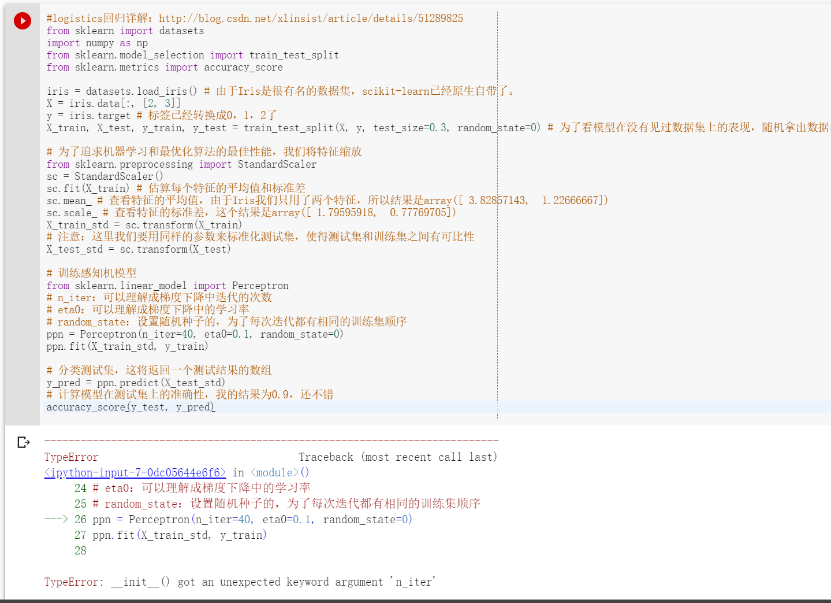
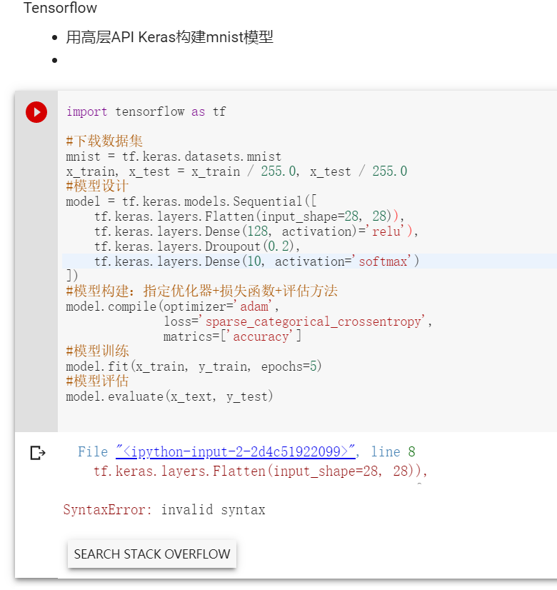
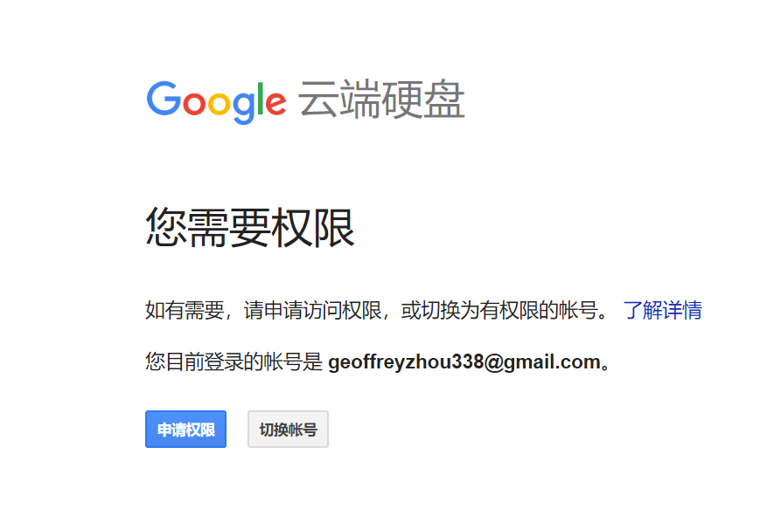
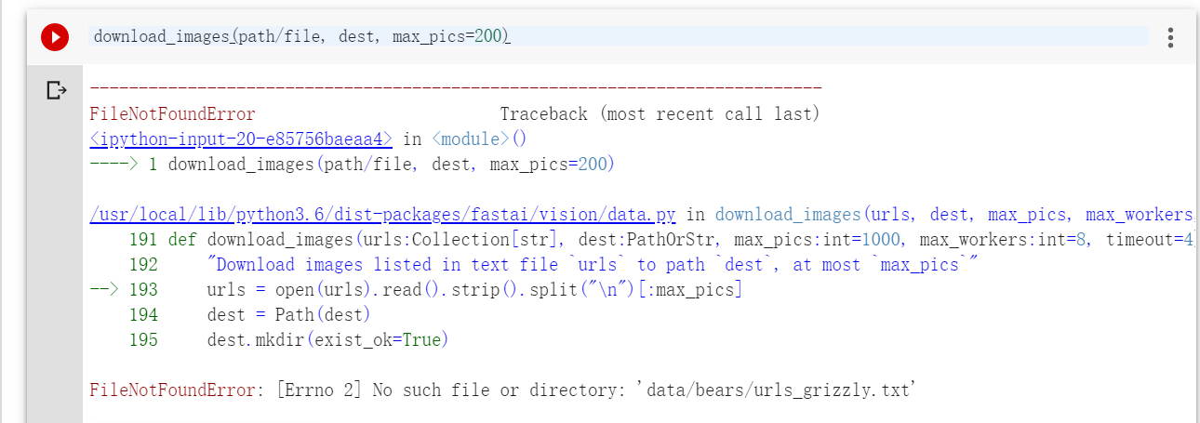
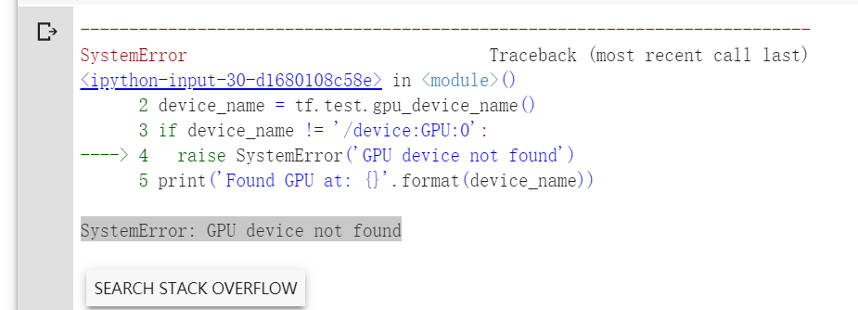

Slide 37
文科生的fastai学习之路
———从不放弃到战胜恐惧
一个小白想进入AI圈，可能不止要经历“九九八十一难！”
面对无背景、无技术的窘境，不少“AI萌新”的自学生涯还没有开始就结束了。
一、人生若只如初见
二、隔行如隔山（最兴奋时刻，最痛苦时刻）
三、三天不练饿得慌

Slide 38
向王奇文老师致敬！
感谢alpha老师的鼓励！
感谢School of AI—Beijing！
感谢清华大学数据院！

Slide 39
Thank you for your attention!

